Slide 1


A Deep Learning-Enhanced Statistical Machine Translation of Filipino Local Languages
Proponents:
Misa, Tom Andre
Rafailes, Christian Jake Eliezer.
Javier, Kynth.
COLLEGE OF COMPUTING EDUCATION |BACHELOR OF SCIENCE IN COMPUTER SCIENCE
Notes:
(0:30) Title and team introduc1on
• (1:00) The problem of the study and motivation
• (1:00) Research objectives
• (1:00) Research method
• (10:00) Software demo
• (1:30) Results and conclusions (for Final)

Slide 2



Background of the Study
The Philippines is an island country in Southeast Asia, and its culture and history is diverse. There are many spoken languages and dialects due to the diversity of its people, such as Hiligaynon and Tagalog.
Hiligaynon is the language spoken in the Western Visayas region, and it is also known as Ilonggo to the locals.
Hiligaynon and Filipino are the two languages that are rich in cultural and linguistic subtleties, which presents a unique and complex pair for machine translation. The two languages are distinct yet similar due to shared cultural and historical influences since they came from the same language family, the Austronesian Family of Language
The problem with achieving a correct translation is that machines need help picking up on the nuances of speech. Something spoken in Hiligaynon translated into Tagalog or Filipino will sometimes come across as broken in either grammar, structure, or both
COLLEGE OF COMPUTING EDUCATION

Slide 3
Background of the Study
One popular model well-known for its capacity to incorporate context from previous and subsequent items in a data sequence is the Bidirectional Long Short-Term Memory (Bi-LSTM) model. This distinct quality has excellent potential for overcoming the difficulties in translating between Filipino and Hiligaynon.
The Bi-LSTM's bidirectionality enables the model to fully comprehend the linguistic environment by deftly grasping the nuances of the language's syntax and semantics. Integrating Bi-LSTM into a statistical machine translation system represents a significant advancement.
The translation model can consider both the present input and the language elements that will be added in the future with this addition. This forward and backward information flow makes a more sophisticated understanding of the original language possible, improving the system's capacity to provide linguistically and culturally accurate translations.
COLLEGE OF COMPUTING EDUCATION

Slide 4
The Objectives
General Objectives
To improve the accuracy and precision of translating words and sentences in the Filipino language, layers and grid search optimization will be added to the current Bidirectional LSTMs to improve statistical machine translation and achieve better accuracy and precision in translating words and sentences.
Specific Objectives
To create a model for statistical machine translation that uses a bidirectional LSTM to change to Hiligaynon & Filipino only.
To tokenize and normalize text to carry out data pre-processing and clean the necessary resources that call for an effective word translation between the Hiligaynon and Filipino languages from dictionaries and open-source data sets.
Using the provided data sets, run a simulation using the baseline and suggested Bidirectional LSM Statistical Machine Translation model.
To evaluate the experimental findings between the baseline and suggested models to determine which model performs better in accuracy when translating text in Filipino and Hiligaynon.
COLLEGE OF COMPUTING EDUCATION

Slide 5
Review of Related Literature
A case study on the use of LSTM to translate French to Senegalese. The researchers found the case study to be close to what the researchers are trying to achieve with their own study, that being the use of LSTM to translate Spanish to Filipino.
Accuracy Findings:
Baseline LSTM - 56.69%
LSTM + Attention – 63.89%
LSTM + Bidirectional – 68.03%
LSTM + Attention + Bidirectional – 72.27%
COLLEGE OF COMPUTING EDUCATION

Slide 6
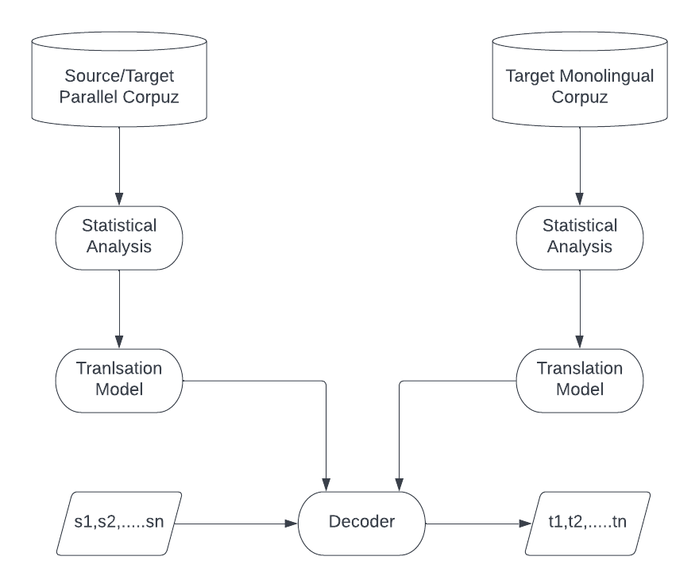
Baseline Model
This study uses IBM Model 1 as the baseline, employing word-based translation and probability assessment via a word alignment technique. It processes translations from source to target words using metrics ranging from one-to-zero, one-to-one, to one-to-many.
Statistical Machine Translation Architecture
COLLEGE OF COMPUTING EDUCATION

Slide 7
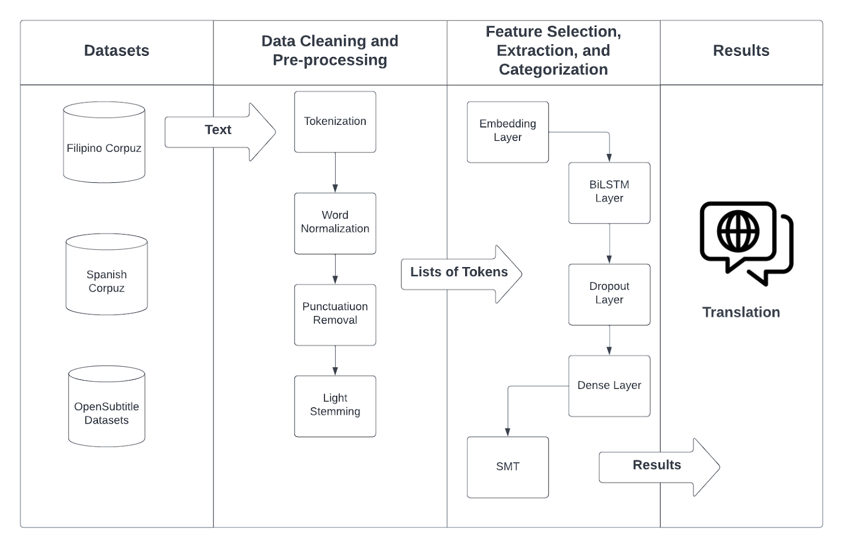
Proposed Model
The proposed model integrates a Bi-LSTM with Dropout and Dense layers to enhance performance, supplemented by advanced data cleaning and preprocessing techniques to achieve acceptable results and improvements.
Hiligaynon
Dictionary Stories Rhymes Songs
Framework of Proposed Model
COLLEGE OF COMPUTING EDUCATION

Slide 8
Feature Selection, Extraction, and Categorization
Embedding Layer
The Embedding layer is used to create word vectors for incoming words. It sits between the input and the LSTM layer, the output of the Embedding layer is the input to the LSTM layer.
Dropout Layer
The term “dropout” refers to dropping out the nodes in a neural network. All the forward and backwards connections with a dropped node are temporarily removed, thus creating a new network architecture out of the parent network. Dropout layer ignores a set of neurons randomly this layer normally used to prevent net from overfitting.
Dense Layer
Dense layer is a layer that is deeply connected with its preceding layer which means the neurons of the layer are connected to every neuron of its preceding layer. This layer is the most commonly used layer in neural networks
COLLEGE OF COMPUTING EDUCATION

Slide 9
Data Cleaning and Preprocessing
Tokenization
Word Normalization
Punctuation Removal
Stemming
COLLEGE OF COMPUTING EDUCATION

Slide 10
Software Demo
COLLEGE OF COMPUTING EDUCATION

Slide 11
Results & Discussion
Model Implementation
Utilizes IBM Model 1, known for simplicity and effective lexical translations. Operates on word alignment mechanism, initialized using Hidden-Markov Alignment. Data preparation includes cleaning, tokenizing, and building vocabulary essential for training.
Training Process
Iterative estimation of word probabilities conditioned on valid pairs. Utilizes unigrams and bigrams to model language structure and learn patterns. Analyzes sentence fragments to grasp meanings and contexts. Training data limited to approximately 5000 unique words and 2000 repeated words.
COLLEGE OF COMPUTING EDUCATION

Slide 12
Results & Discussion
Base Model Results Evaluation
The Base Model achieved a BLEU score of 24.81%, indicating basic comprehension but with noticeable grammatical errors. It showed a 55.35% probability of producing correct translations, though it struggled with complex vocabulary and sentence structures. A high number of mistranslations and untranslatable words highlighted its limitations in accurately translating between Filipino and Hiligaynon.
Enhancement with Bi-LSTM
With the integration of Bi-LSTM, the model’s performance improved. The BLEU score increased to 26.42%, and translation accuracy rose by 12.90%. This enhancement significantly reduced mistranslations and untranslatable words, reflecting better handling of complex and rare terms. The Bi-LSTM’s dual-directional context provided deeper sequence understanding, leading to clearer and more accurate translations.
COLLEGE OF COMPUTING EDUCATION

Slide 13
Conclusion
The IBM Model 1 of Statistical Machine Translation achieved a BLEU score of 24.81%, with a fair translation quality with noticeable grammatical errors. The integration of Bi-LSTM improves the translation accuracy to 26% demonstrating the effectiveness of bidirectional contextual learning. The model provides solid foundation for word-based translation and probabilistic translation model and the addition of Bidirectional LSTM enhanced its translation quality by incorporating multiple layers and its capability of contextualizing data from both directions. In Addition, there is also an increase of average probability score of 12.90% upon testing its average score.
COLLEGE OF COMPUTING EDUCATION

Slide 14
The baseline model had a 55.35% chance of generating correct translations but faced challenges with complex vocabulary and sentence construction. Its frequent mistranslations and untranslatable terms revealed its limitations in accurately translating between Filipino and Hiligaynon.
In contrast, the enhanced model notably decreased both mistranslations and untranslatable words, showing improved capability in managing complex and less common terms. The use of Bi-LSTM, with its bidirectional context processing, contributed to a deeper understanding of sentence structure and produced more precise translations.
COLLEGE OF COMPUTING EDUCATION

Slide 15
Recommendation
Model Selection:
Evaluate the specific requirements and constraints of translation tasks and deciding continuing the IBM Model 1 or another variant of the IBM Model
Optimization
Enhance accuracy and efficiency through advance parameter optimization techniques.
Use Large Datasets to minimize errors and improve quality accuracy translation
Comparative studies
Assess model adaptability for different contexts.
Perform benchmark studies comparing enhanced Statistical Machine Translation (SMT) models with modern models like the Transformer
Adopt Neural Machine Translation
Consider the benefit of NMT system, especially in handling complex language patterns
Bi-LSTM or LSTM in general are easy to integrate into NMT system
Data Challenges for Less Common Languages
Address the scarcity of resources for less commonly spoken languages like Hiligaynon.
Highlight challenges such as limited digital presence and smaller speaker population
Emphasize the need for comprehensive and diverse datasets.
COLLEGE OF COMPUTING EDUCATION

Slide 16
References
Alla Lo, Cheikh M. Bamba Dione, Elhadji Mamadou Nguer, Sileye O. Ba, & Moussa Lo. (2020). Using LSTM Networks to Translate French to Senegalese Local Languages: Wolof as a Case Study. ArXiv: Computation and Language. https://arxiv.org/pdf/2004.13840.pdf
Bensalah, N., Ayad, H., Adib, A., & Ibn El Farouk, A. (2021). LSTM vs. GRU for Arabic Machine Translation. Advances in Intelligent Systems and Computing, 156–165. https://doi.org/10.1007/978-3-030-73689-7_16
Bowman, M., Debray, S. K., & Peterson, L. L. (1993). Reasoning about naming systems. ACM Trans. Program. Lang. Syst. 15, 5 (Nov. 1993), 795-825. DOI= http://doi.acm.org/10.1145/161468.161471.
Brown, L. D., Hua, H., & Gao, C. (2003). A widget framework for augmented interaction in SCAPE. In Proceedings of the 16th Annual ACM Symposium on User interface Software and Technology (Vancouver, Canada, November 02 - 05, 2003). UIST '03. ACM Press, New York, NY, pp. 1–10. DOI= http://doi.acm.org/10.1145/964696.964697
Elfaik, H., & Nfaoui, E. H. (2020). Deep Bidirectional LSTM Network Learning-Based Sentiment Analysis for Arabic Text. Journal of Intelligent Systems, 30(1), 395–412. https://doi.org/10.1515/jisys-2020-0021
Hang Thi-Thuy Do, Huy Duc Huynh, Kiet Van Nguyen, Ngan Luu-Thuy Nguyen, & Anh Gia-Tuan Nguyen. (2019). Hate Speech Detection on Vietnamese Social Media Text using the Bidirectional-LSTM Model. ArXiv: Computation and Language. https://arxiv.org/pdf/1911.03648
Makarenkov, V., Rokach, L., & Shapira, B. (2019). Choosing the right word: Using bidirectional LSTM tagger for writing support systems. Engineering Applications of Artificial Intelligence, 84, 1–10. https://doi.org/10.1016/j.engappai.2019.05.003
Mohaouchane, H., Mourhir, A., & Nikolov, N. S. (2019). Detecting Offensive Language on Arabic Social Media Using Deep Learning. 2019 Sixth International Conference on Social Networks Analysis, Management and Security (SNAMS). https://doi.org/10.1109/snams.2019.8931839
Negia, M., Tamiru, R., & Meshesha, M. (2022). Amharic-Kistanigna Bi-directional Machine Translation using Deep Learning. 2022 International Conference on Information and Communication Technology for Development for Africa (ICT4DA), 61-65. https://doi.org/10.1109/ICT4DA56482.2022.9971194.
Zhang, F., Xu, Shaohang. (2019).Short-Term Vehicle Speed Prediction Based on Convolutional Bidirectional LSTM Networks. https://ieeexplore.ieee.org/stamp/stamp.jsp?arnumber=8865046
VU, V. H., NGUYEN, Q. P., NGUYEN, K. H., SHIN, J. C., & OCK, C. Y. (2020). Korean-Vietnamese Neural Machine Translation with Named Entity Recognition and Part-of-Speech Tags. IEICE Transactions on Information and Systems, E103.D(4), 866–873. https://doi.org/10.1587/transinf.2019edp7154
Y.T. Yu, M.F. Lau, "A comparison of MC/DC, MUMCUT and several other coverage criteria for logical decisions," Journal of Systems and Software, 2005, in press.
Zhiheng Huang, Peng Xu, Davis Liang, Ajay Mishra, & Bing Xiang. (2020b). TRANS-BLSTM: Transformer with Bidirectional LSTM for Language Understanding. ArXiv: Computation and Language.
Tokenex (2022). What is Tokenization? From https://www.tokenex.com/blog/what-is-tokenization/
COLLEGE OF COMPUTING EDUCATION

Slide 17
References
Lopez, D. (2021). Text Normalization for Natural Language Processing (NLP). https://towardsdatascience.com/text-normalization-for-natural-language-processing-nlp-70a314bfa646
Minsoo, C., Jihwan, H., Chihyun, P., Sanghyun P. (2020). Combinatorial Feature embedding based on CNN and LSTM for biomedical named entity recognition. https://www.sciencedirect.com/science/article/pii/S1532046420300083
Labach, A., Salehinejad, H., Valaee, S., (2019) Survey of Dropout Methods for Deep Neural Networks. https://arxiv.org/pdf/1904.13310.pdf
Josephine, H., Nirmala, A.P., Alluri, V. L. Impact of Hidden Dense Layers in Convolutional Neural Network to enhance Performance of Classification Model. https://iopscience.iop.org/article/10.1088/1757-899X/1131/1/012007/pdf
Brown, P., Pietra, V., Pietra, S., Mercer, R. The Mathematics of Statistical Machine Translation: Estimation.https://aclanthology.org/J93-2003.pdf
Tan, Z. Et al. Neural machine translation: A review of method, resources, and tools. https://www.sciencedirect.com/science/article/pii/S2666651020300024
Bonet, I, C . Statistical Machine Translation A practical Tutorial. https://www.cs.upc.edu/~cristinae/CV/docs/tutorialSMTprint.pdf
Srivastav, A. Normalization Formula. https://www.wallstreetmojo.com/normalization-formula/
Och, F., Ney H. Improved Statistical Alignment Models. https://aclanthology.org/P00-1056.pdf
Oorja. (2020). Stackoverflow Q/A, what is the difference between bigram and unigram text feature extraction. Online: https://stackoverflow.com/questions/43463792/what-is-the-difference-between-bigram-and-unigram-text-features-extraction
Tran, H., Tran, H,. Nguyen, S., Nguyen, H., & Nguyen, T. (2019). Does BLEU Score work for Code Migration? 2019 IEEE/ACM 27th International Conference on Program Comprehension (ICPC), 165-176. https://doi.org/10.1109/ICPC.2019.00034.
Google Cloud. Guides, Evaluating Model, Understanding the BLEU Score. From https://cloud.google.com/translate/automl/docs/evaluate#:~:text=BLEU%20(BiLingual%20Evaluation%20Understudy)%20is,of%20high%20quality%20reference%20translations.
The Difference between Statistical and Neural Machine Translation. From https://www.prestigenetwork.com/insights/the-difference-between-statistical-and-neural-machine-translation/
COLLEGE OF COMPUTING EDUCATION

Slide 18
COLLEGE OF COMPUTING EDUCATION

